Slide 1


Multimedia University
MACHINE LEARNING BASED
MALICIOUS WEBSITE
DETECTION & RESPONSE SYSTEM
Bachelor of Information Technology (Hons.) (Security Technology) | FYP2 presentation
Chong You Xin | 1211108623 | FIST | Supervisor: Prof. Ts. Dr. Heng Swee Huay

Slide 2


Multimedia University
Introduction
Phishing
Impersonates trusted brands to steal user credentials, financial data, and spread malware.
Malicious URLs proliferate rapidly - bypassing traditional blacklist-based detection systems
New phishing domains are registered daily - static databases insufficient for real-time protection
Why detection matters
Users require early, real-time warnings while browsing - prevent credential theft
Browser-integrated detection provides the most immediate layer of protection at the point of risk
Machine learning enables dynamic, pattern-based detection beyond static blacklists, adapting to new and unseen threats

Slide 3
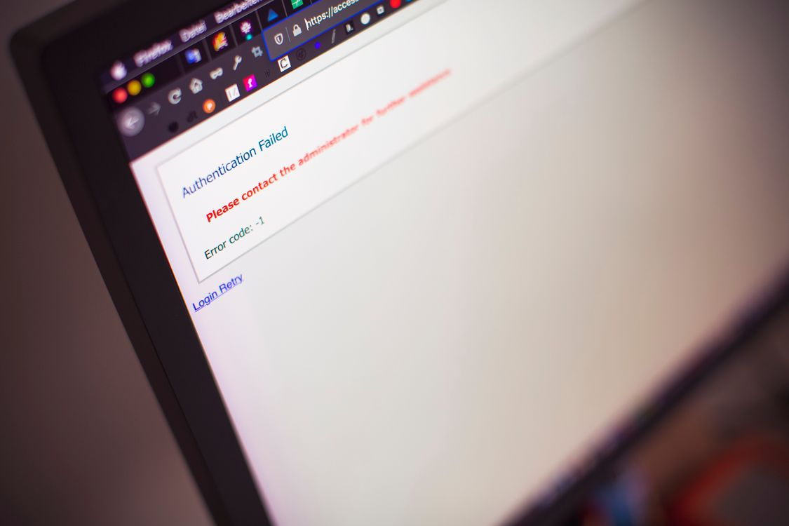
Multimedia University
Problem Statement
& Objective
Users may unknowingly visit phishing or malicious websites.
Blacklist-based detection fails against new, unseen URLs, leaving users exposed to credential theft and malware in real time.
To design and develop a machine learning model that identifies if a website is malicious or legitimate based on URL and the website features.
To build a prototype system that integrates detection and provides automated responses accordingly

Slide 4
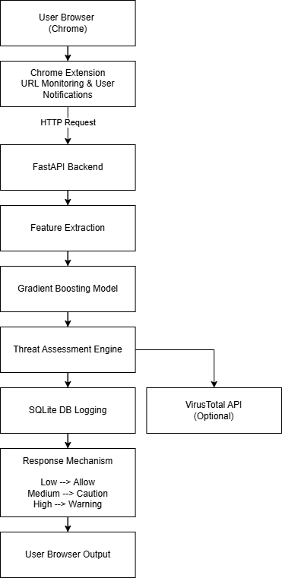

Multimedia University
Risk level handling:
Proposed Solution
& ----------------------
System Architecture
Low Risk →
Allow access
Medium Risk → Caution warning shown
High Risk →
Block page displayed
System Pipeline:
Chrome Extension → FastAPI
Backend → Feature Extractor → ML Model → Risk Result
• Browser extension Monitors top-level web navigations, excluding internal browser and local pages.
• Backend classifies URL risk level using Gradient Boosting
Confidence score and risk explanation provided to user

Slide 5

Multimedia University
Feature
Extraction
Lexical Features
Structural
Features
Trust & DOM Features
• URL length
• Dot count
• Digit count
• Hyphen count
• Shannon entropy
• Special character count
• Path depth
• Query length
• Query parameter count
• IP address presence
• Suspicious TLD detection
• Punycode detection
• Executable/script path detection
• Known trusted domain check
• Brand/domain mismatch check
• Password field detection
• Hidden iframe presence
• External script count
• Suspicious page text signals

Slide 6
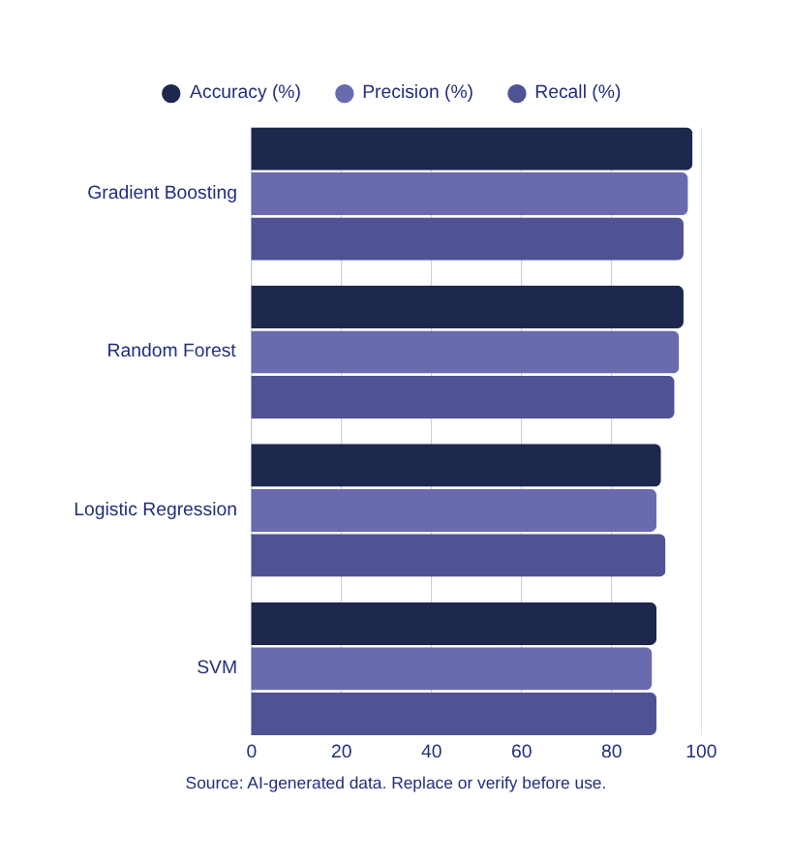
Multimedia University
ML Model
Comparison
Four machine learning models were trained and evaluated on the same labeled URL dataset:
• Gradient Boosting
• Random Forest
• Logistic Regression
• Support Vector Machine (SVM)
Gradient Boosting was selected as the final model due to its superior balance of accuracy, malicious recall, and minimal false positives on legitimate URLs.
Source: Model comparison results from project evaluation report.

Slide 7

Multimedia University
Demonstration

Slide 8

Multimedia University
Key Performance Metrics — Gradient Boosting Model:
• Accuracy: 98.31%
• Malicious Precision: 98.28%
• Malicious Recall: 95.00%
• ROC-AUC Score: 0.9924
• High-Risk Classification Threshold: 0.90
• Hard-Negative False Positive Rate: 0.00%
Key Takeaway: Gradient Boosting achieves the optimal balance between malicious URL detection and false positive reduction. With near-perfect precision and a zero false-positive rate on hard negatives, the model reliably distinguishes phishing and suspicious URLs from legitimate ones — making it a suitable choice for real-time browser-based deployment.
Results &
Evaluation

Slide 9

Multimedia University
Conclusion
Limitations
• Mostly URL-centric; limited page content analysis
• Local backend must be running
• Dataset can be expanded for better generalization
The project demonstrates a real-time malicious URL detection prototype using a Chrome extension and machine learning backend.
Future Works
• Redirect-chain analysis
• Certificate and WHOIS features
• Larger and fresher dataset
• Better privacy controls

Slide 10
Multimedia University
Thank You!

